Slide 1



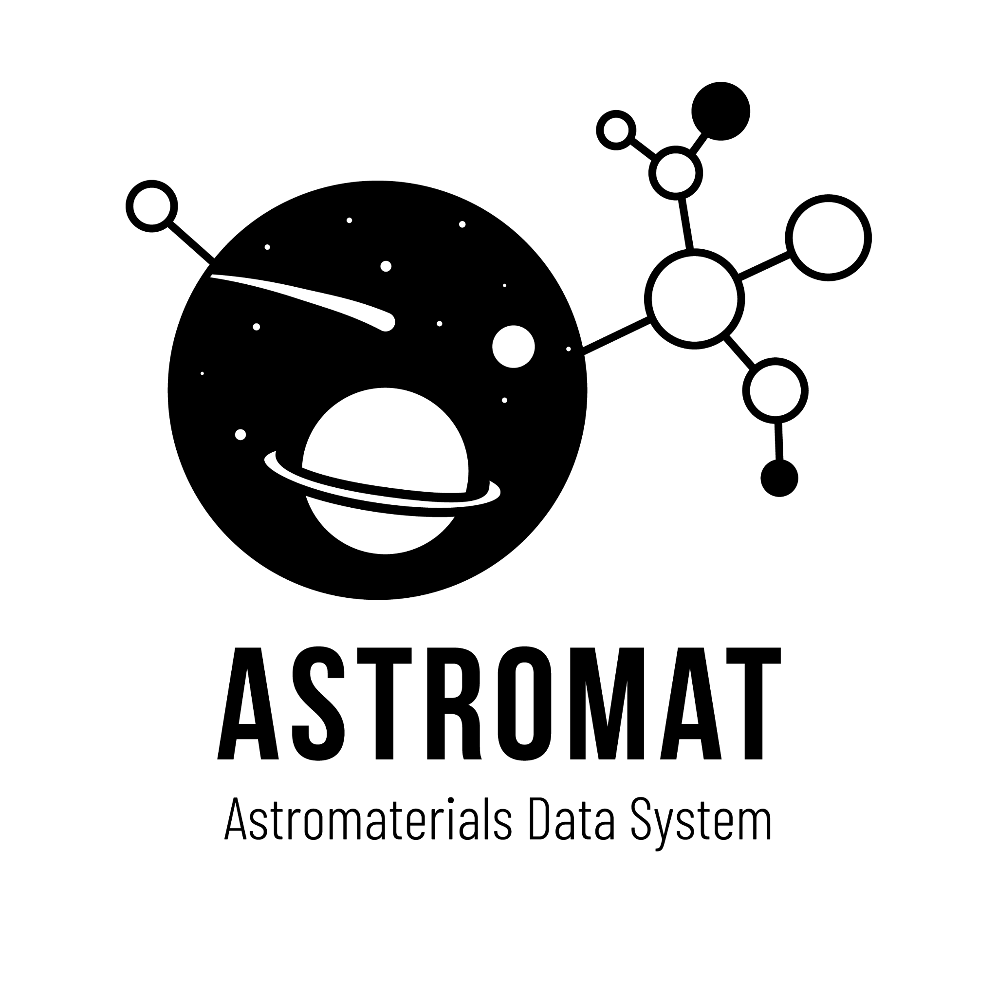
TAPP: Community-Recommended Best Practices for Documenting Analysis
Ruolin Deng
Aug 2026
Geoinformatics Research Group
LDEO-Columbia University

Slide 2
Metadata
TLDR: Data about other data.
Definition: Metadata is information that describes, contextualizes, and enables the discovery, evaluation, and reuse of data.

Slide 3
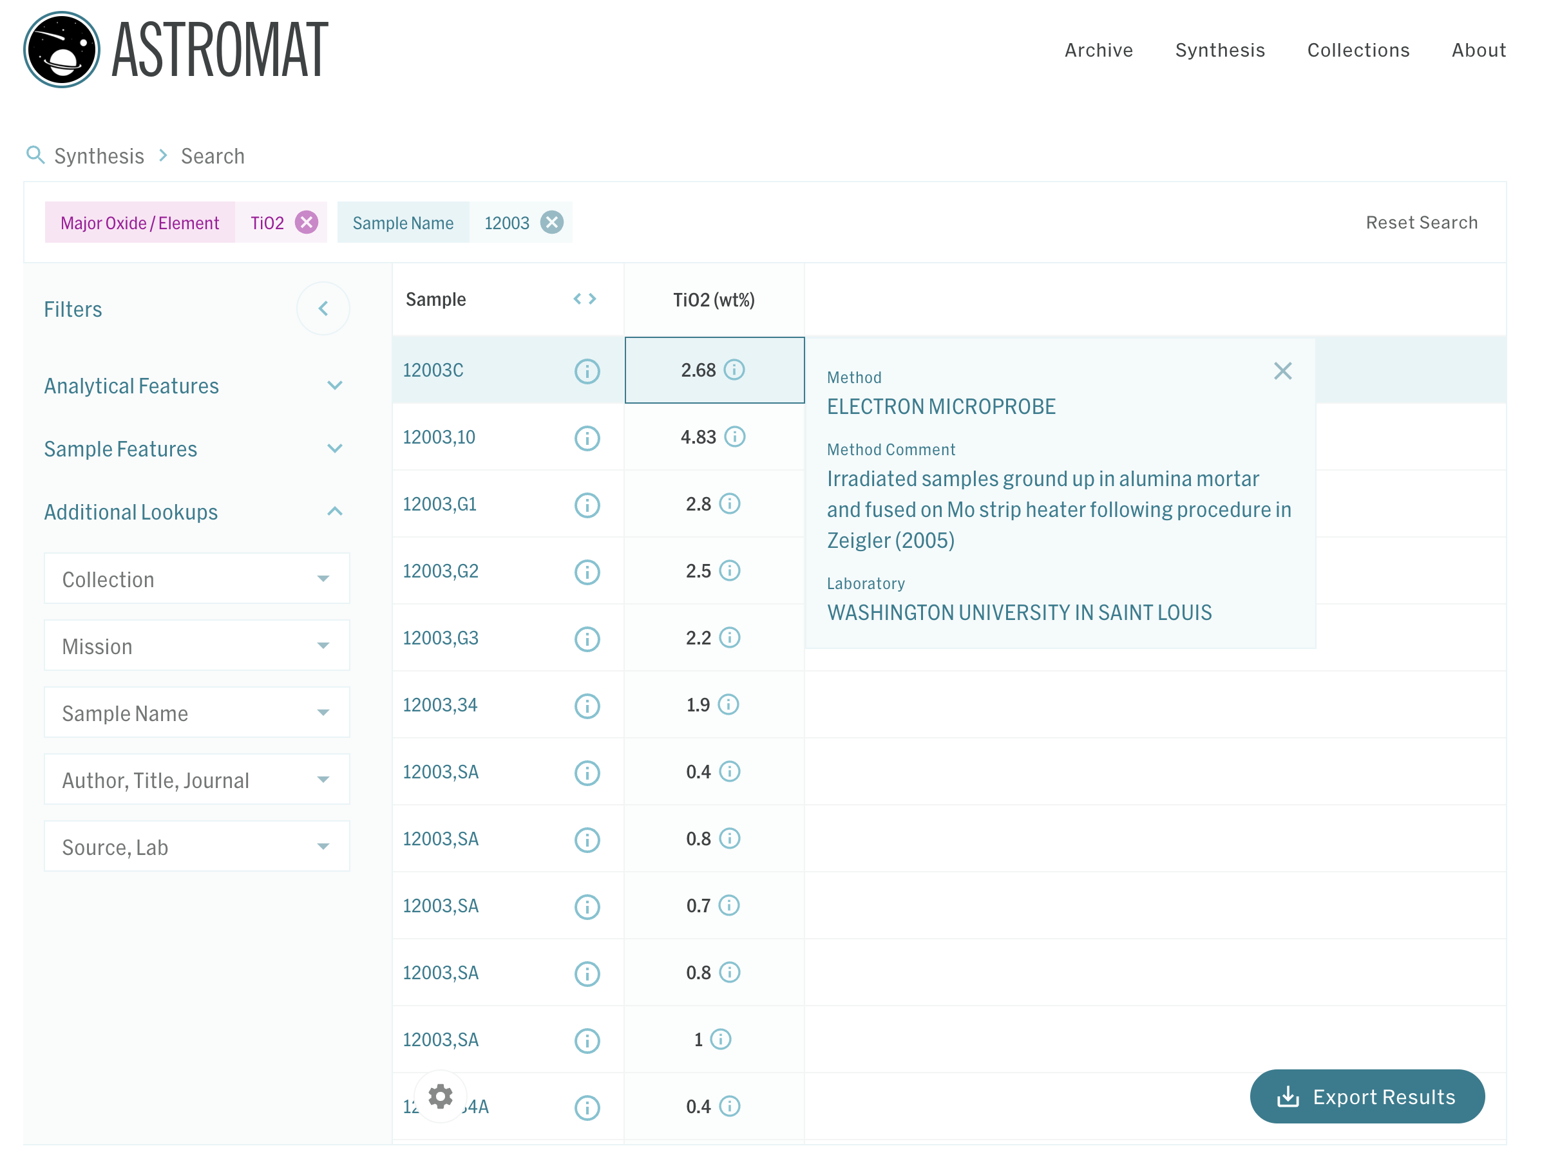
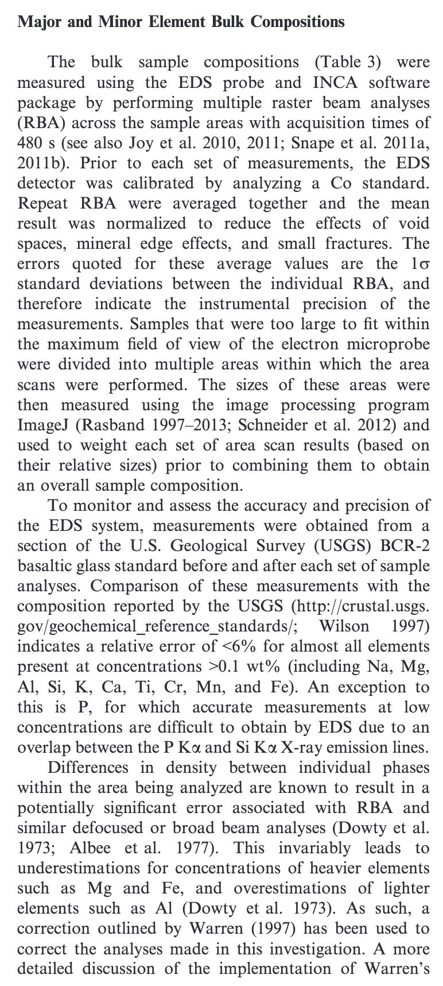
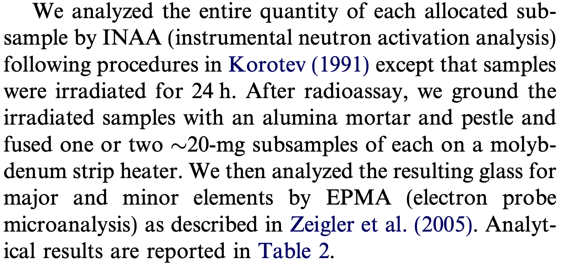

Scenario 1: A researcher reusing data.
Samples
Sample and sample preparation.
Instrument & Software
Analytical hardware and software.
Measurement Info
Data Processing
QC & Uncertainty
How raw data is generated.
How raw data is processed.
How good data is.
Target: Examine relevant metadata to evaluate, reproduce, or reuse data.
Issue: Heterogeneity in metadata reporting.

Slide 4
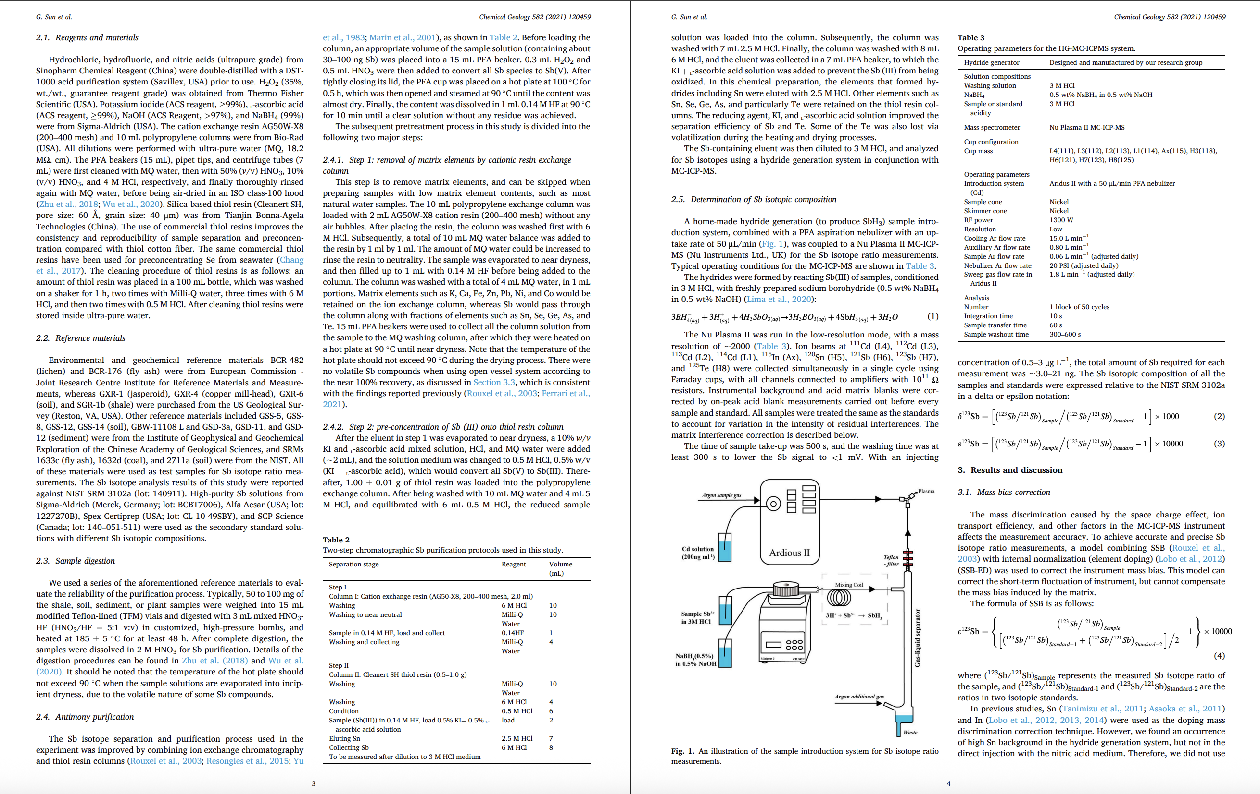
Scenario 2: A researcher generating data.
VIM3: A procedure is a description of a measurement according to one or more measurement principles and to a given measurement method, based on a measurement model and including any calculation to obtain a measurement result.
Target: Decide which procedure or analysis metadata you should provide with data.
Scientific Question
Samples
Sample and sample preparation.
Instrument & Software
Analytical hardware and software.
Measurement Info
Data Processing
QC & Uncertainty
How raw data is generated.
How raw data is processed.
How good data is.
Issue: No standard for documenting procedure/analysis metadata.
Project Design
Procedure Metadata
Project Implementation
Analysis Metadata
Data

Slide 5
Issue for data re-user: Heterogeneity in metadata reporting.
Issue for data provider: No procedure/analysis metadata documentation standard.
Solution: Community-endorsed standards.
TAPP: Technique-Aligned Procedure Profiles

Slide 6
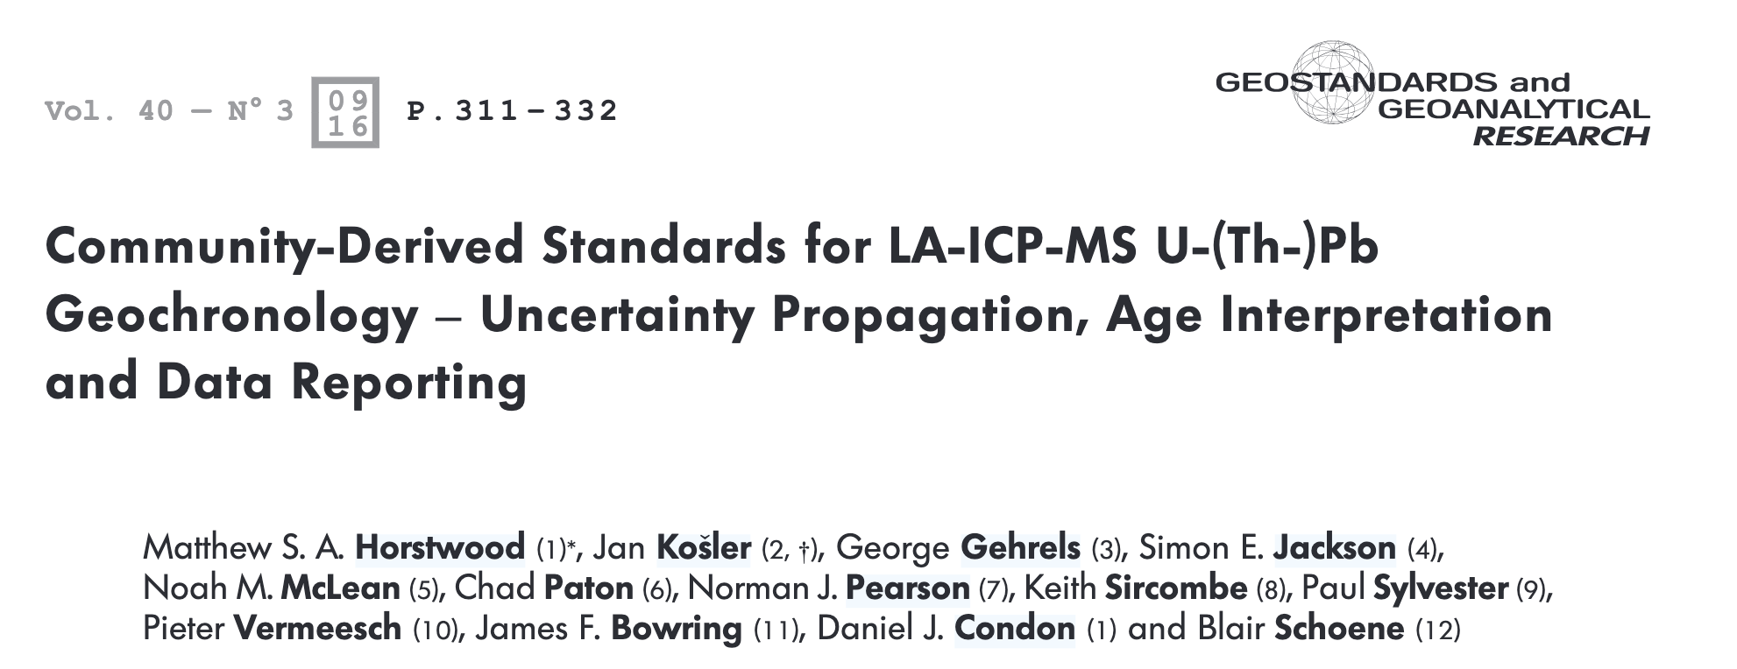
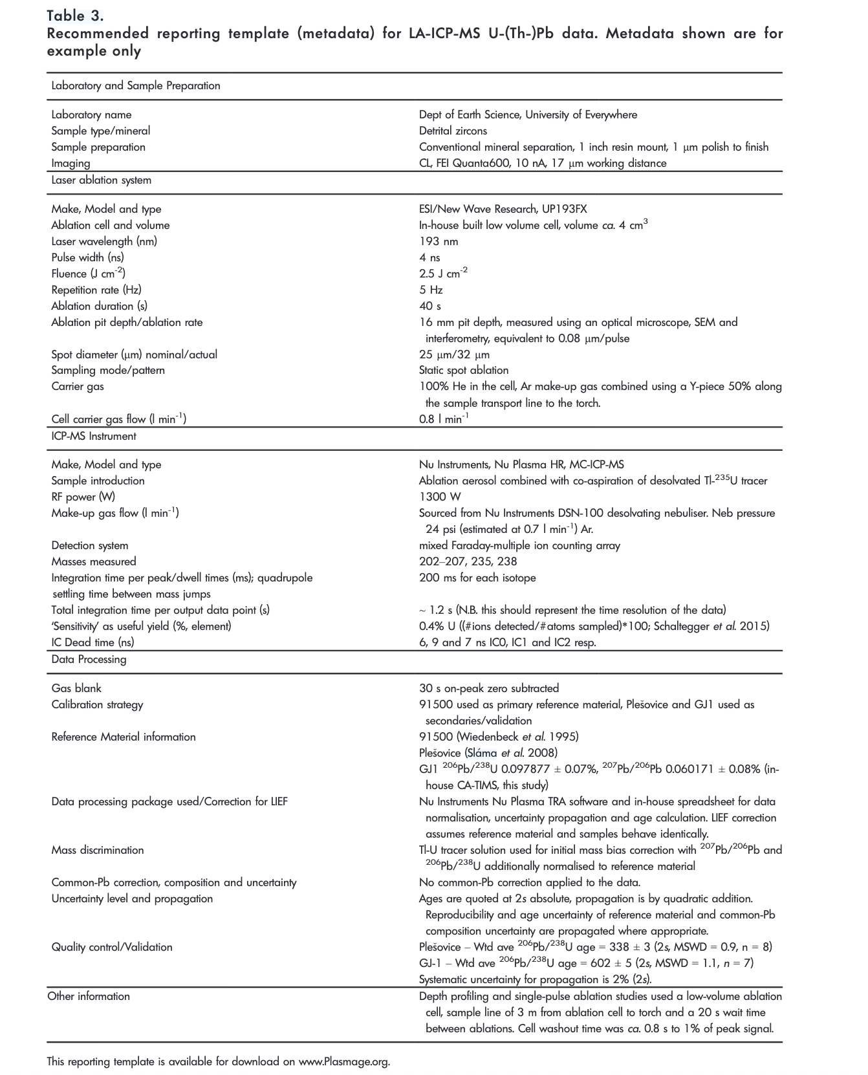
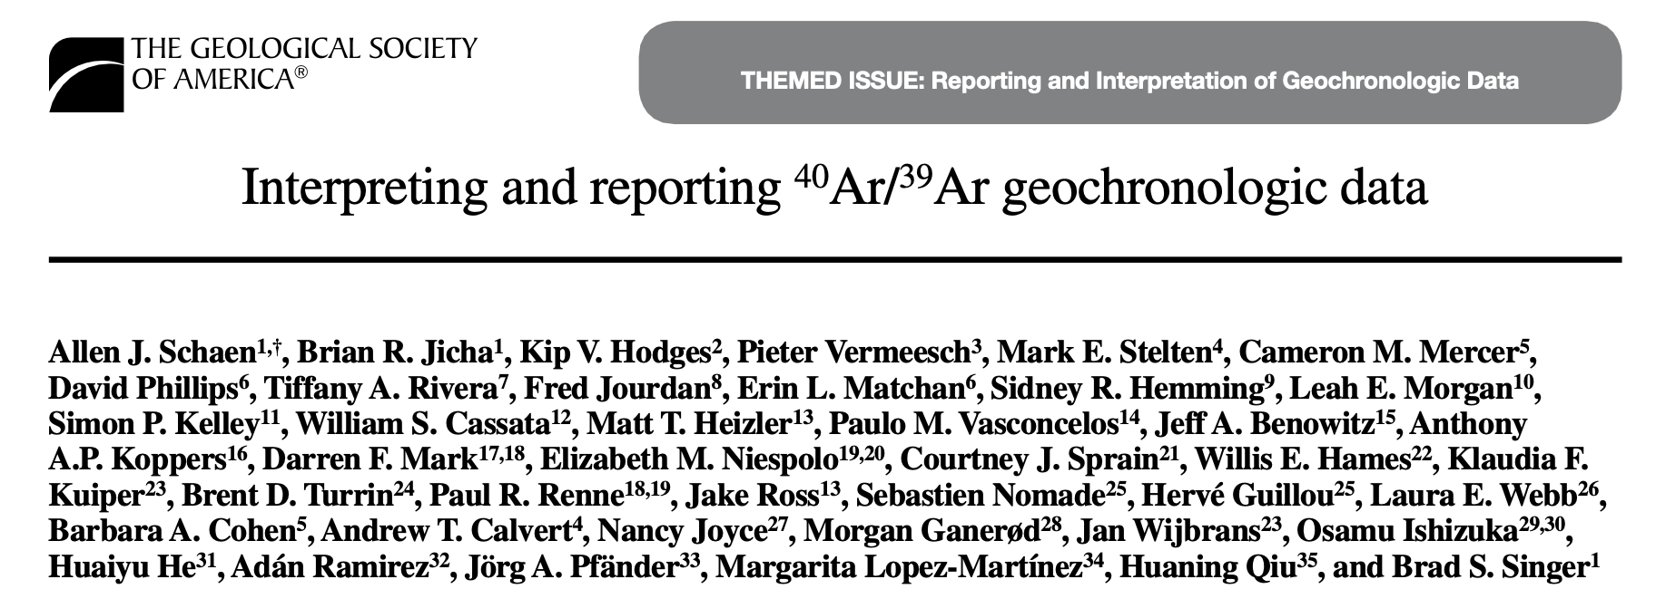
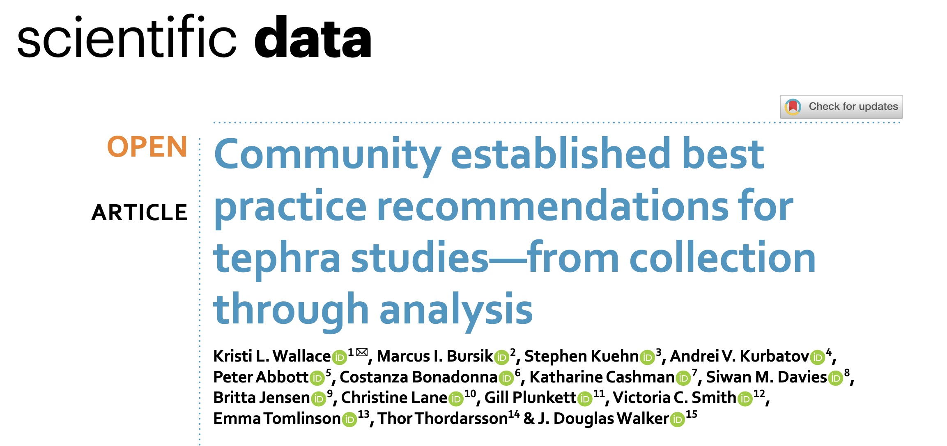
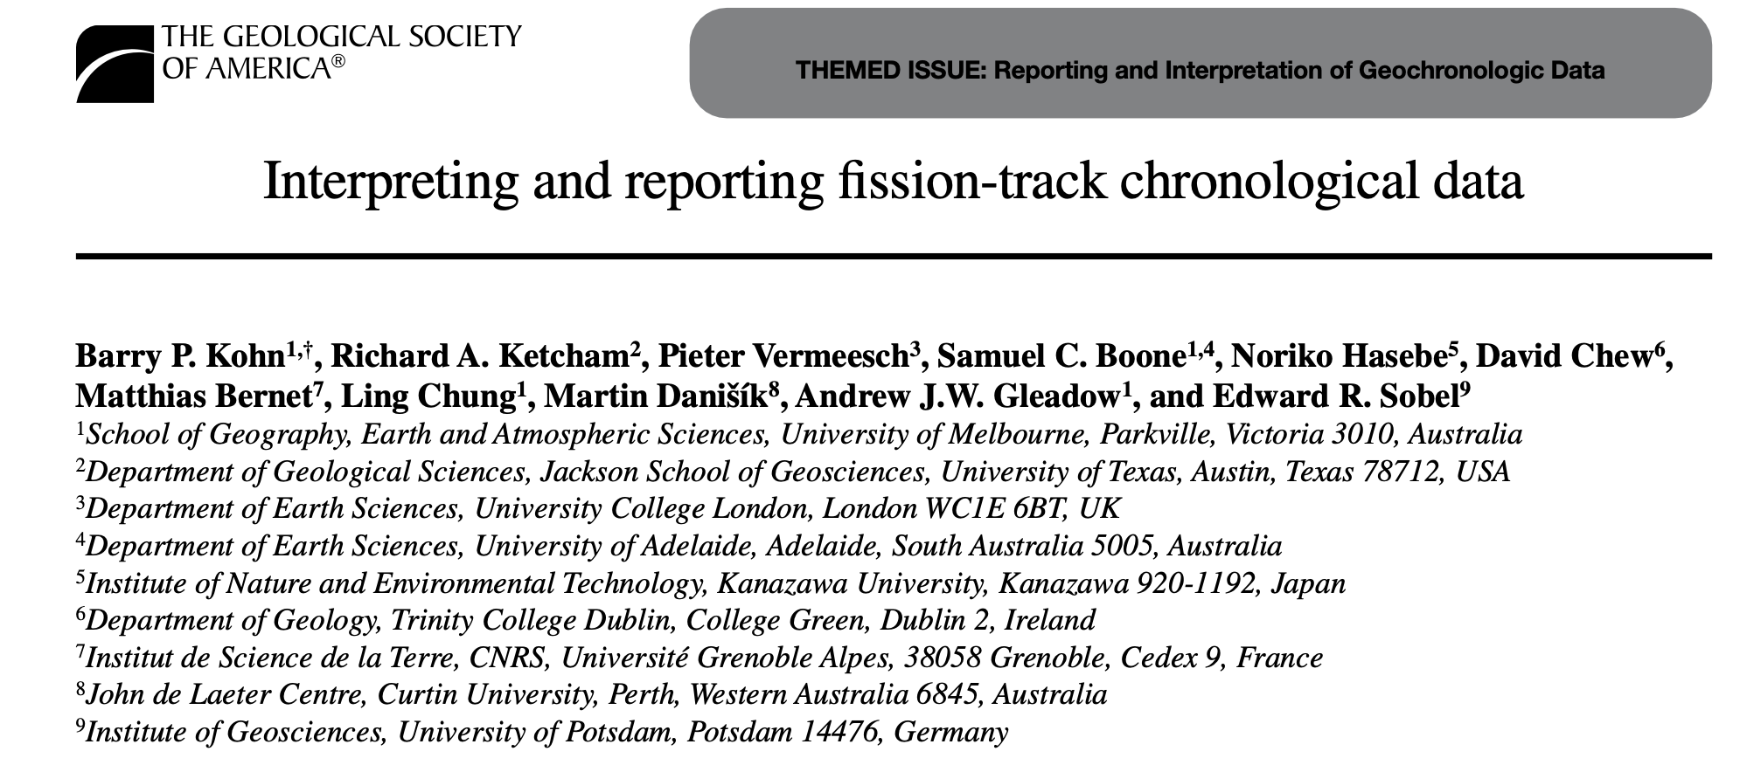
Current landscape
1. Developed by working groups composed of domain experts through dedicated meetings and/or workshops.
2. Geochronologists are taking the lead.
3. We would like to cover all geoscience-relevant techniques.

Slide 7
TAPP
Itemized, community-recommended best practices for reporting analytical procedures.

Slide 8
Definitions and the Analytical Hierarchy
WDS on Electron Probe Micro-Analysis (EPMA)
“Olivine major element composition analysis by EPMA-WDS”
Procedure A (LDEO)
Procedure B (NASA JSC)
“Carbonate trace element composition analysis by EPMA-WDS”
Procedure A (NASA JSC)
Technique
The principle(s) of a measurement
Method
The application of a technique
Procedure
The “recipe” of a method
Measurement/Analysis
The implementation of a procedure
Procedure B (Caltech)
Session 05/01/2026
Session 05/20/2026
Session 03/01/2026
Session 04/15/2026
Session 03/25/2026
Session 04/15/2026
Data
The product of a procedure
Dataset A
Dataset B
Dataset C
Dataset D
Dataset E
Dataset F
Metadata
The data about data

Slide 9
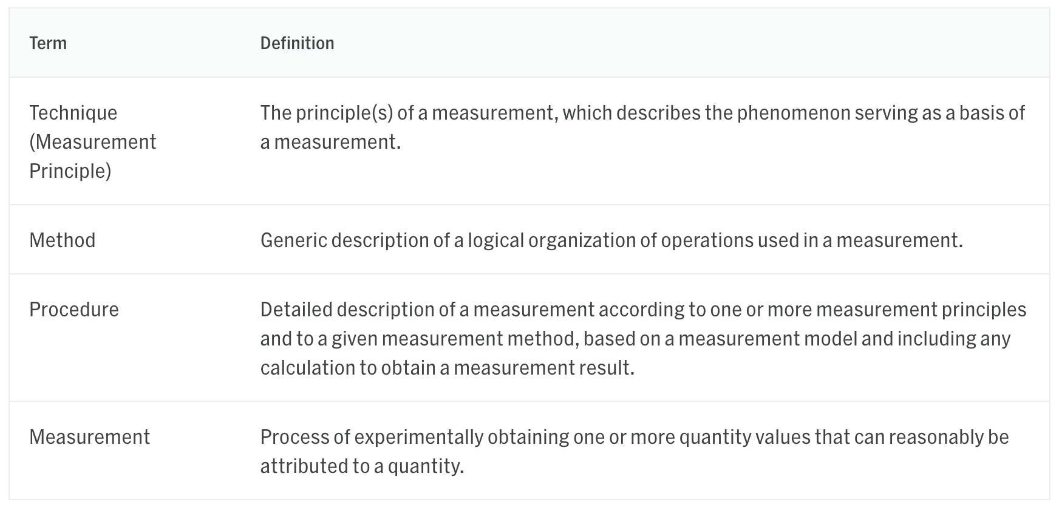
Definitions Following VIM3

Slide 10
TAPP Structure
Procedure Identification
Astromat policy
Samples
Instrument & Software
Measurement Info
Data Processing
QC & Uncertainty
Domain knowledge
From publications, assuming on average they reflect community-endorsed best practices for reporting procedures and analyses.

Slide 11
TAPP Dev with LLM and Human Experts
Procedure is often reported in tables, footnotes, or natural language descriptions.
Strengths with LLM:
Great with natural language processing and analysis
Great with flexible metadata formats
Parallelization and automation.
What LLM is not good at:
Identifying rigorously reported procedure
Judging quality of TAPP for data reproducibility
Needs human input
Domain experts will review each TAPP

Slide 12
TAPP Development Workflow
Human Experts
Agentic AI
Output
Review papers
Scope & Analytical Mode Identification
TAPP Template
Seed Methodology
Papers
TAPP Generation Agent
Preliminary TAPP
Procedure Applications
Reflection Agent
Expert Evaluation
JSON Generation Agent
Finalized TAPP
TAPP JSON Schema

Slide 13
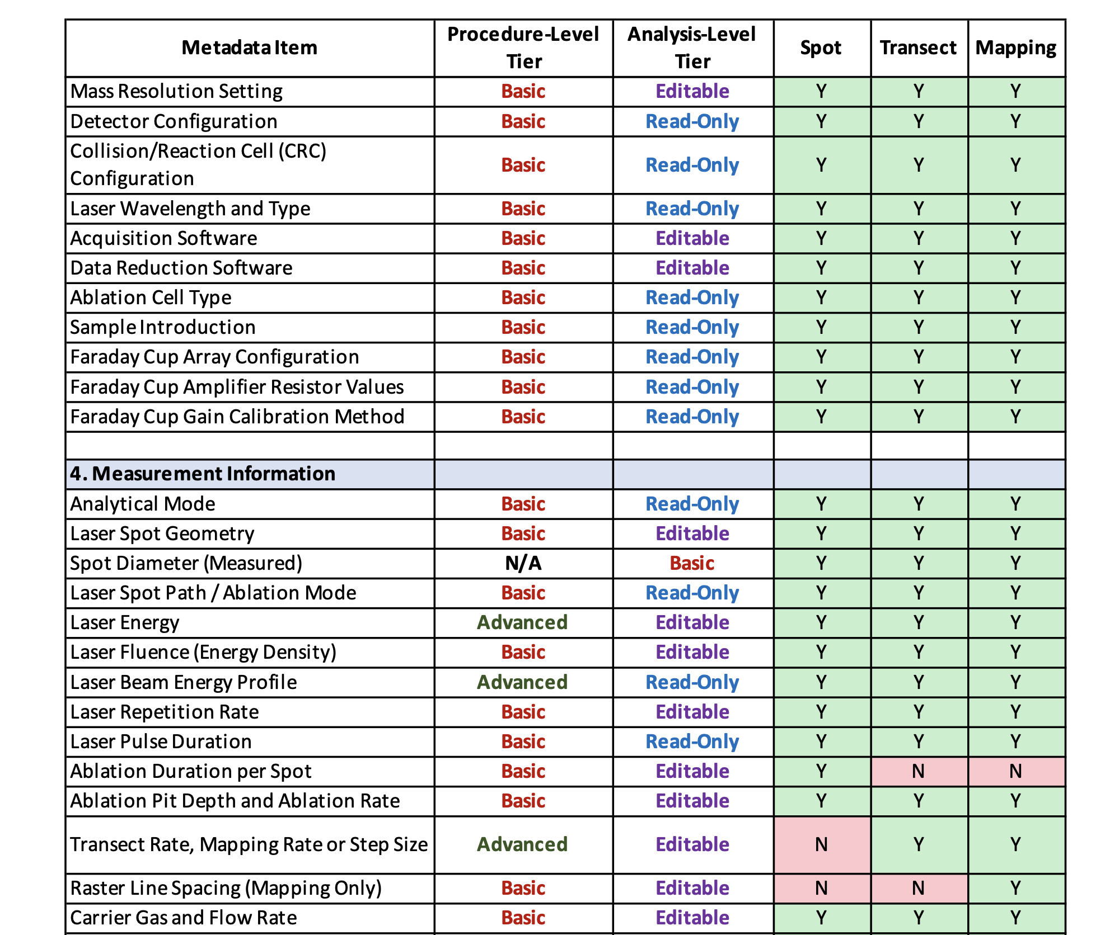
A TAPP example

Slide 14
TAPP Development Progress
Ready for expert review — 11 TAPPs
✓ Electron Probe Microanalysis (EPMA)
✓ Scanning Electron Microscopy (SEM
✓ Transmission Electron Microscopy (TEM)
✓ LA-Q/SF-ICP-MS and its U-Pb Geochronology variant
✓ LA-MC-ICP-MS and its U-Pb Geochronology variant
✓ Solution Q-ICP-MS
✓ Solution SF-ICP-MS
✓ Solution MC-ICP-MS
✓ Laboratory X-ray CT (Lab-XCT)
High-Priority Planned
○ Noble Gas Mass Spectrometry
○ ⁴⁰Ar/³⁹Ar Geochronology
○ SIMS / NanoSIMS
○ Raman Vibrational Spectroscopy
○ XRD / XRF
○ GC-MS / EA-IRMS
○ TIMS / VNMIR / XANES / ...
Covering 2/3 of data submitted to Astromat Data Archive by OSIRIS-Rex SAMIS team at University of Arizona.

Slide 15
Looking forward

Slide 16
How to use TAPPs
A checklist for data providers when reporting procedures/analyses.
A test for data re-users when evaluating data reproducibility and reusability.
A standard to align publishers, databases, and funding agencies.
A kernel for building automated procedure registration and validation tools.
Allows procedure reusing and versioning.
Supports peer-review requirements by funding agencies like NASA.
A foundation for structured, machine-readable records of procedure/analysis metadata.
Enrich parameter space for data-driven algorithms.
Enable more complex, customized data search needs.

Slide 17
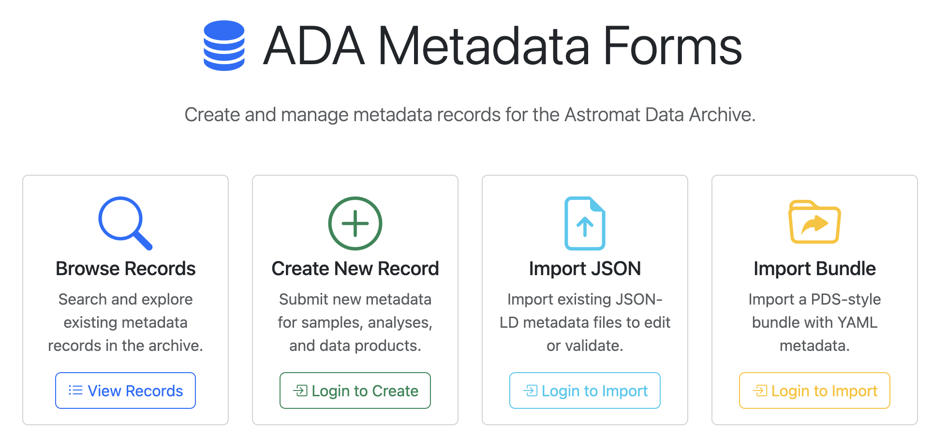
TAPP for machine-readable metadata curation
Procedure Design
Procedure Metadata Assessment
Procedure Registration
Procedure Implementation (Analysis)
Data
TAPP
Machine-readable Procedure Record
Machine-readable Analysis Record
Data Bundle
Relevant tools and user interfaces are under development at Astromat.
Database (e.g., Astromat)

Slide 18

Sign up to be a TAPP expert reviewer today!

Slide 20
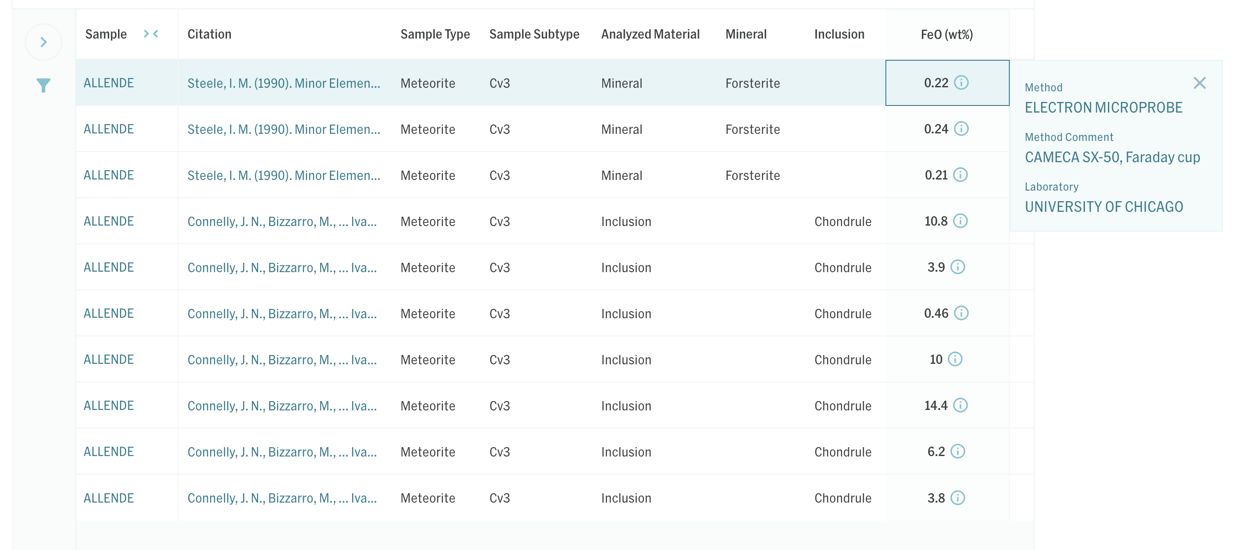
Data in Astromat Synthesis
Administrative Metadata
Sample Metadata
Data
Analytical Metadata

Slide 21
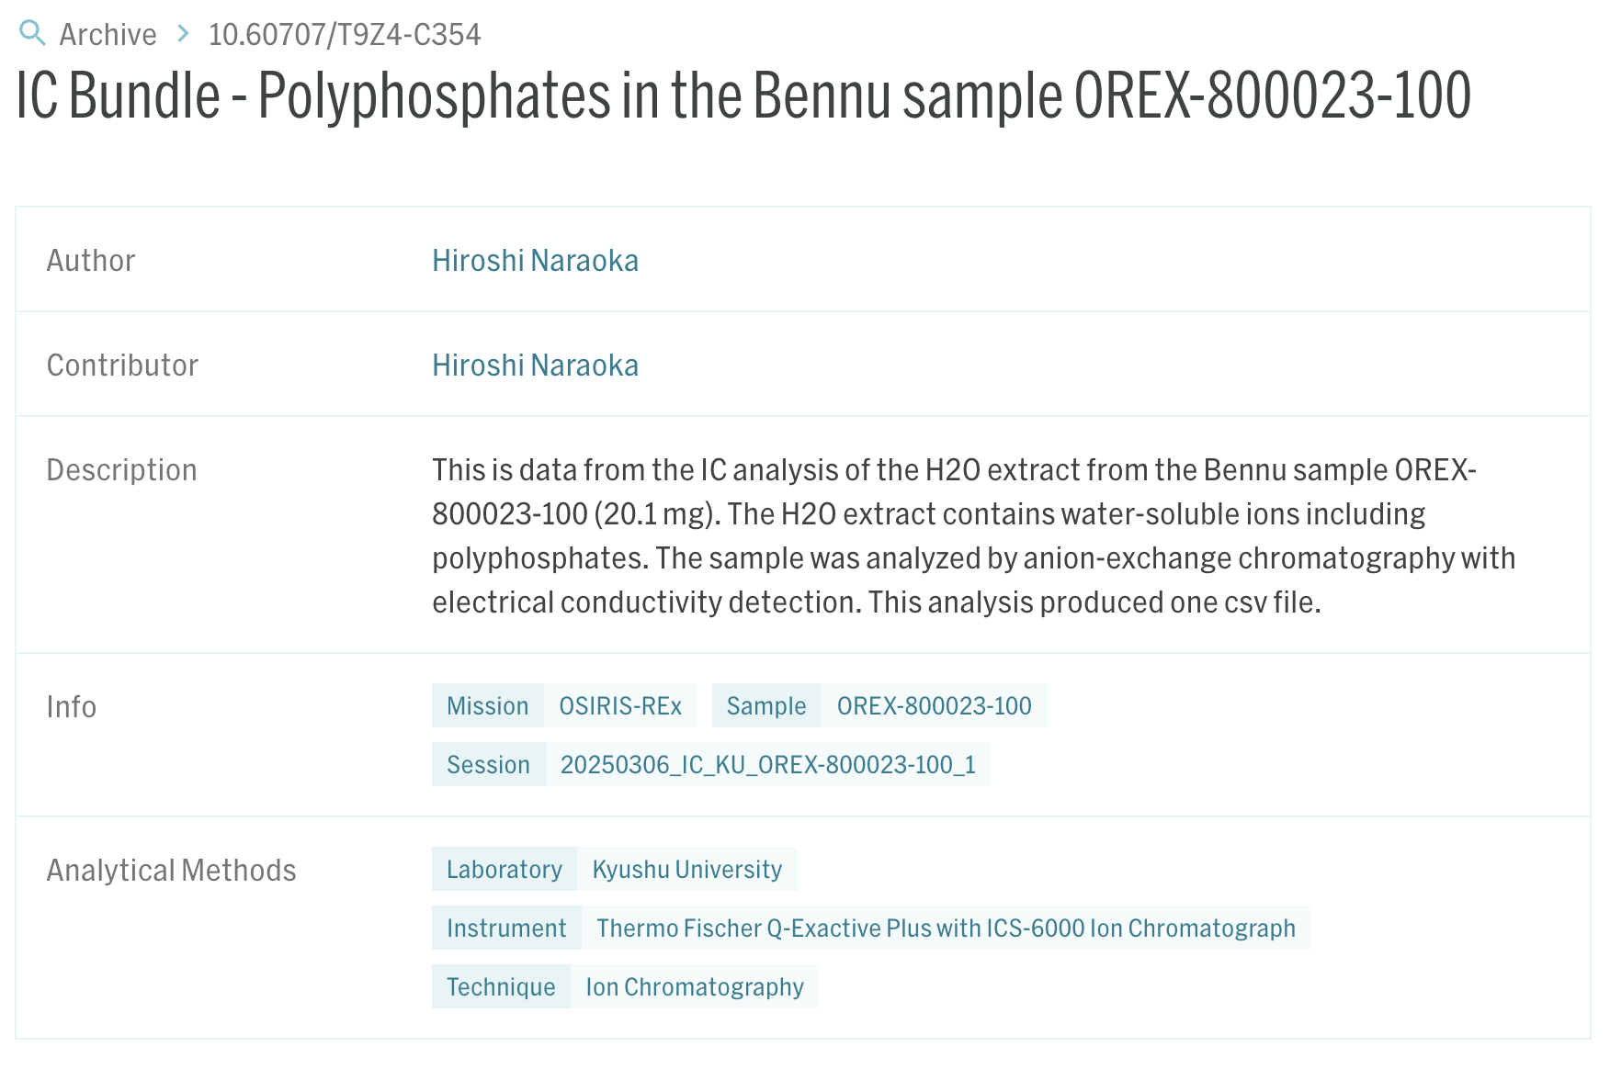
Data in ADA
Bibliographic Metadata
Analytical Metadata
Sample Metadata

Slide 22
Types of Metadata in Geoscience
Administrative Metadata:
Title, dataset creator, publication date, data type…
Usually required in a database.
Sample Metadata:
Sample name, material, unique persistent identifier (e.g., IGSN)…
Usually required in a database.
Analytical Metadata:
Technique, Method: usually required in a database
procedure, Procedure: detailed steps of how measurements were made, important for data quality evaluation and reproducibility — not commonly required in databases and rarely standardized.

Slide 23
Administrative Metadata
Dataset title
Sample Metadata
Sample name
Analytical Metadata
Instrument type
Data type
Author
Publication date
Funding
License
Lab
…
Sample treatment
Sample material
Persistent unique identifier (e.g., IGSN)
…
Instrument configuration and setting
Data acquisition method
Data processing method
Quality control and uncertainty
…

Slide 24
Issues with procedure Metadata Reporting
Decoupled data and metadata between database and publication
Data exist in both publications and databases, while metadata is usually more well reported in publications.
Issue: Difficulty in data quality evaluation and reproducibility by database users
Inconsistent metadata reporting standards
Databases and publishers all have different metadata reporting requirements;
General standards are often too broad, while specified standards are too few.
Issue: Inconsistent metadata reporting standards.
Not in machine-readable or AI-ready formats
Metadata is often reported in tables, footnotes, or natural language descriptions in the main text.
Issue: Incompatibility with machine-learning and AI-ready workflows.
→ This is where TAPP is designed to help.

Slide 25
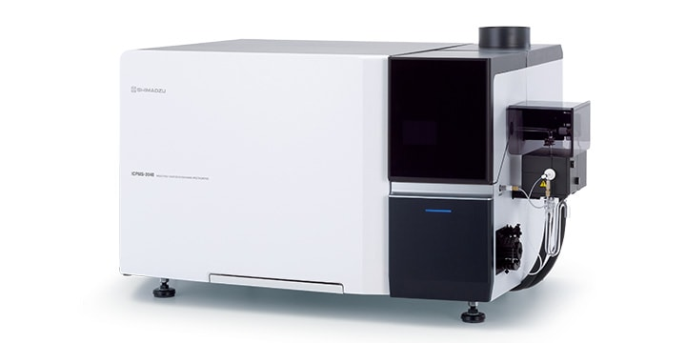

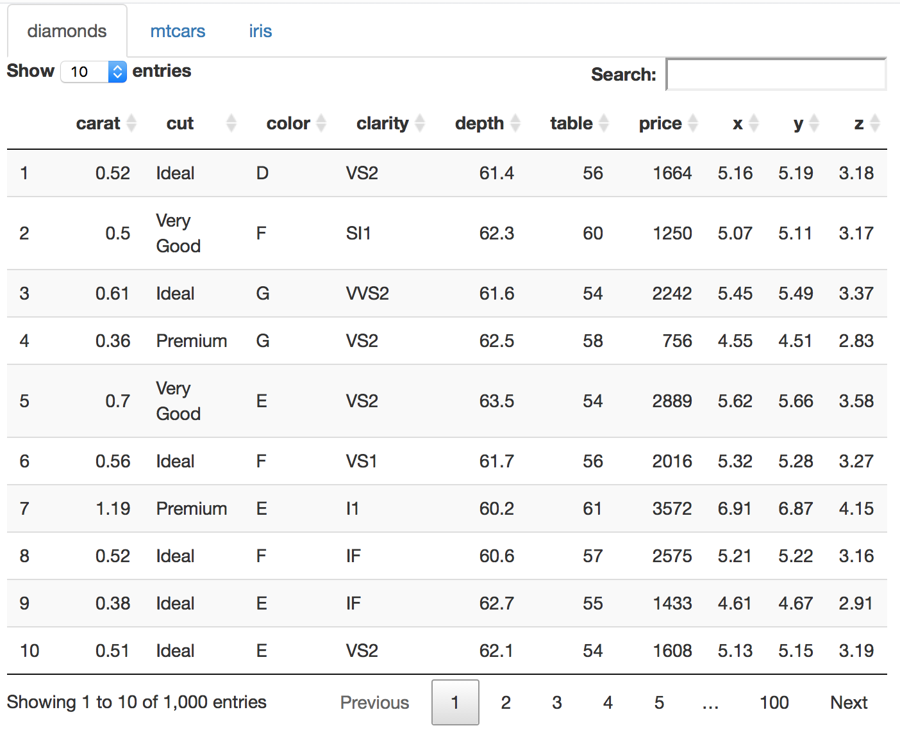
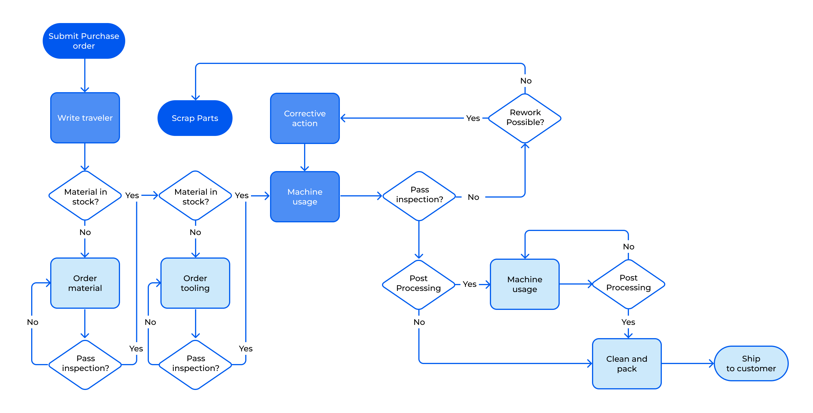

Nomenclature
Technique: a set of chemical or physical principles utilised on an apparatus, instrument, or collection of instruments which can be applied to a sample, material or other medium to yield qualitative or quantitative data.
Method: an application of a technique to a sample, material, or other medium to acquire a specific data type or types, which may provide results and interpretable outcomes.
procedure: a set of stringent guidelines that specify a procedure that an analyst must follow. “What must be done”.
Procedure: a documentation of the actual implementation of a procedure. “What was done”. Note: TAPP captures procedure-level information; Procedure records are out of scope.

Slide 26
A Use Case of TAPP
procedure Metadata Verification with TAPP
procedure Registration
Analytical Procedure following procedure
Data
JSON Record of procedure
JSON Record of Procedure
Data Bundle
Database (e.g., Astromat)

Slide 27
Utility of TAPPs
Help data producers (researchers, labs, commercial labs, etc.) and domain communities create standardized procedure profiles.
procedure registration.
Help researchers produce structured, standardized, machine-readable procedure and procedure documentation.
Help data users interpret, evaluate and reproduce data.
Enrich parameter space for data-driven algorithms.
Enable more complex, customized data search needs.
Help be compliant with metadata requirement and peer review requirement by journals and funding agencies.

Slide 28
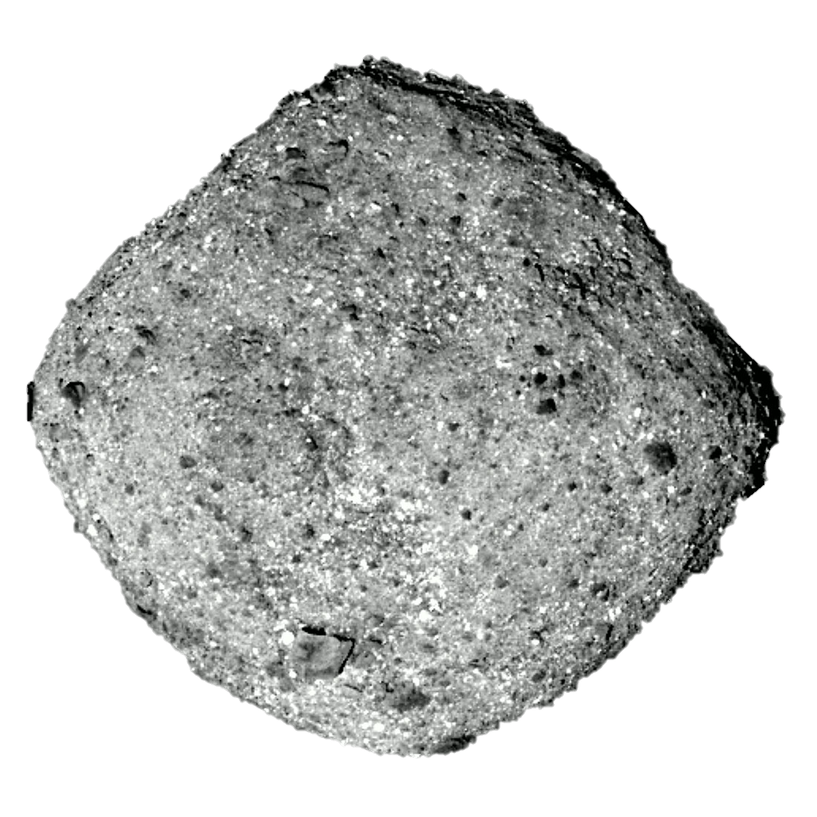
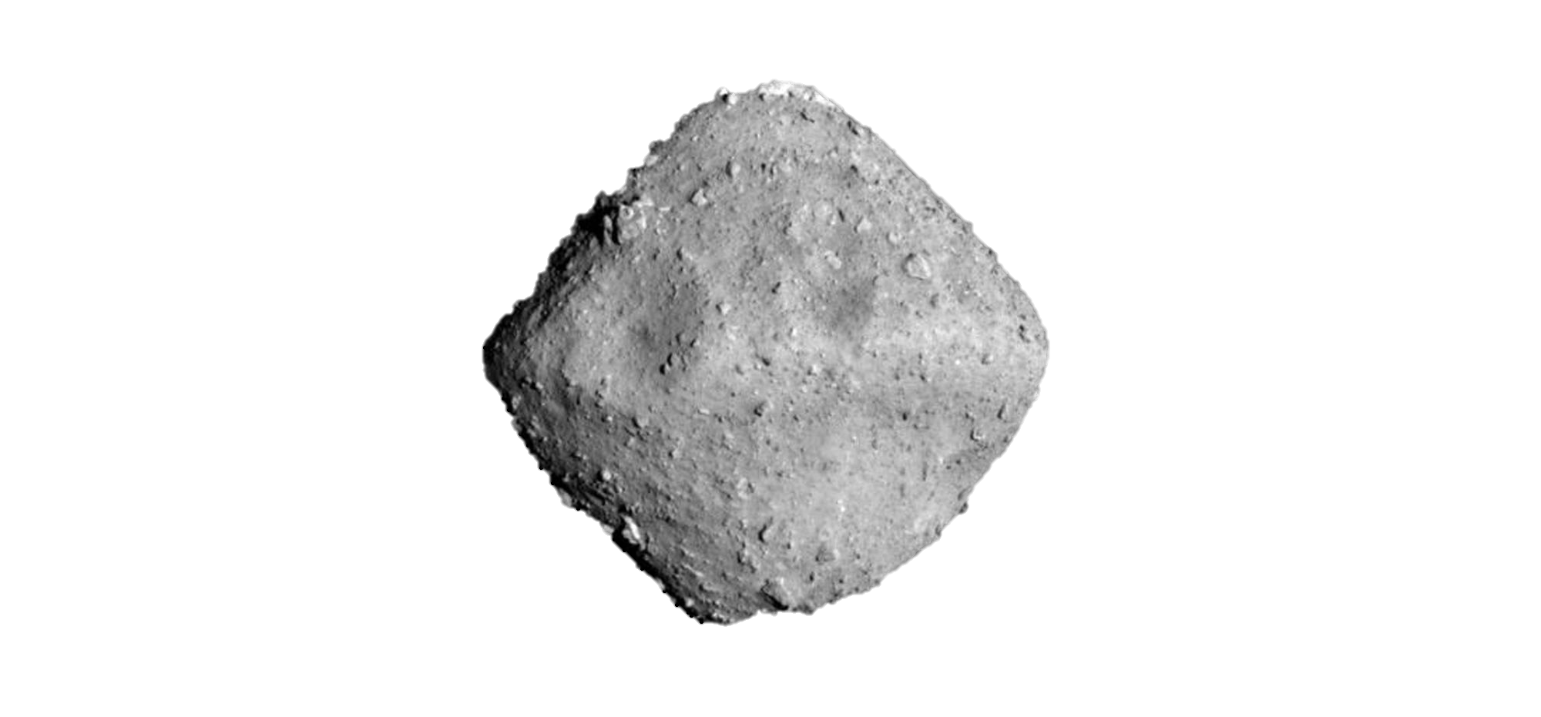

Astromat (astromat.org) is the primary NASA-sponsored archive for laboratory analyses of returned samples from planetary missions as well as meteorites.
Astromaterials Data Archive (ADA)
Astromaterials Data Repository
Astromaterials Data Synthesis
Designated data archive for analytical data generated by the OSIRIS-Rex Sample Analysis Team.
Database for analytical data on astromaterials integrated from existing publications.
> 4,000 Submissions
> 200 Contributors
Data repository for user-submitted digital content on astromaterial analysis.
> 2.5 Million Values
> 5,200 Citations
> 200 Submissions
> 80 Contributors

